Slide 1



INTEGRATION SUPPORT TRAINING, CUSTOMER SERVICE
DISTRIBUTION
March 14, 2025
Cheska Angeline Acance

Slide 2
Agenda
1
2
3
4
DEFINITION OF TERMS AND SYSTEM ARCHITECTURE
BODS AND AGREEMENTS
NAVIGATION
TROUBLE SHOOTING
OIS275 TROUBLESHOOTING
ENTERPRISE COLLABORATOR FAILURE

Slide 3
DEFINITION OF TERMS

Slide 4
DEFINITION OF TERMS
Integrations in ASR for customer service revolves around outbound and inbound BOD documents that are sent from and to different external systems to automate the creation of customer sales orders as well as sending outbound information to trading partners such as order acknowledgements, advance shipment notifications and invoices.
XML
stands for Extensible Markup Language, a markup language designed to store and transport data in a structured, human-readable, and machine-readable format.
API
Application Programming Interface) is a set of rules and protocols that allows different software applications to communicate and exchange data. Think of it as a software intermediary that enables applications to "talk" to each other
BOD
Business object documents (BODs) are XML messages used to exchange data between enterprises or enterprise applications. A BOD is composed of a noun, which identifies the message content, and a verb, which identifies the action to be taken with the document.
Infor ION
Infor's advanced middleware cloud platform, a true integration platform as a service (iPaaS), designed to integrate both Infor and third-party enterprise solutions, acting as a central hub for data flow and connectivity.
EDI Broker
facilitates electronic data interchange (EDI) by acting as an intermediary, translating and delivering business documents between organizations using different EDI standards or formats, essentially acting as a bridge for seamless communication. .
Infor MEC
Infor Enterprise Collaborator, also known as Infor M3 Enterprise Connector (MEC), is an integration tool that facilitates message-based collaboration between Infor M3 Enterprise Management System and other external applications

Slide 5
SYSTEM ARCHITECTURE

Slide 6
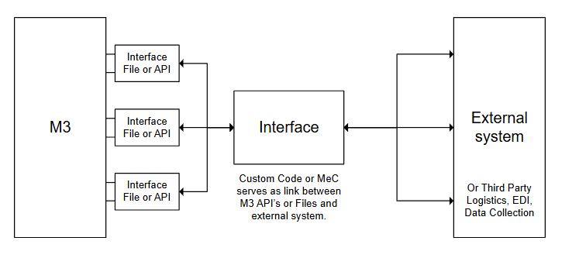
SYSTEM ARCHITECTURE

Slide 7
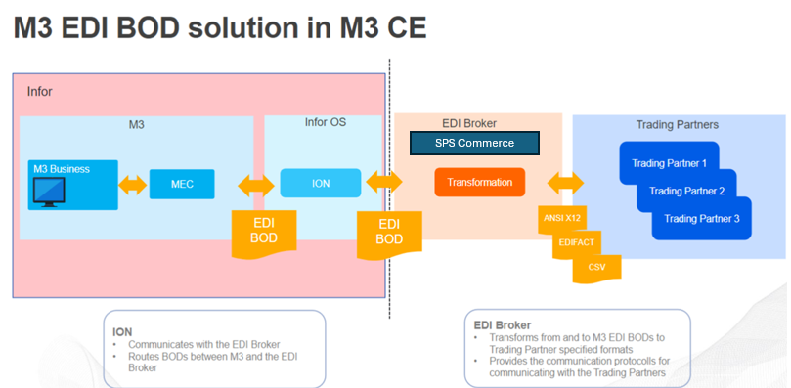
SPS, M3 AND ASR

Slide 8
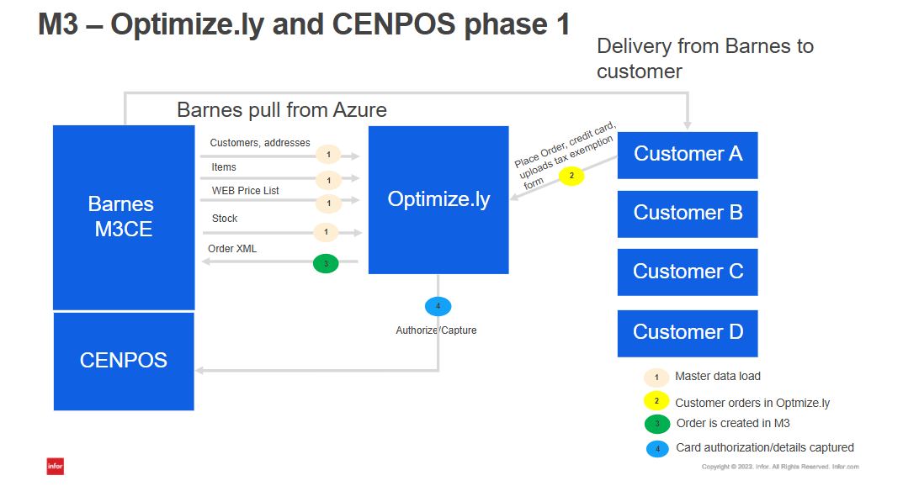
OPTIMIZELY, M3 AND ASR

Slide 9
BODS, AGREEMENT, DOCUMENT NAME

Slide 10
APPLICATION | BOD VERB | BOD NOUN | AGREEMENT NAME (MEC) | DOCUMENT NAME (ONE VIEW)
EDI 850/830/862 | LOAD | M3EDISalesOrder | M3_M3EDISalesOrder_Load_In | Load.M3EDISalesOrder
EDI 855 | SYNC | M3EDISalesOrderAcknowledge | M3_M3EDISalesOrderAcknowledge_Sync_Out | Sync.M3EDISalesOrderAcknowledge
EDI 856 | SYNC | M3EDIShipmentDelivery | M3_M3EDIShipmentDelivery_Sync_Out | Sync.M3EDIShipmentDelivery
EDI 810 | SYNC | M3EDIInvoice | M3_M3EDIInvoice_Sync_Out | Sync.M3EDIInvoice
OPTIMIZELY ORDERS | Process | SalesOrder | M3_SalesOrder_Process_In | Process.SalesOrder

Slide 11
NAVIGATION

Slide 12
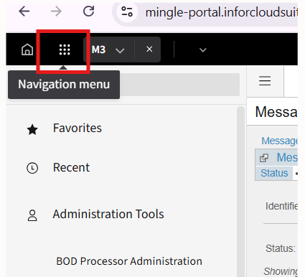
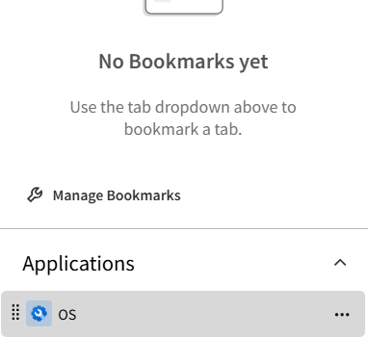
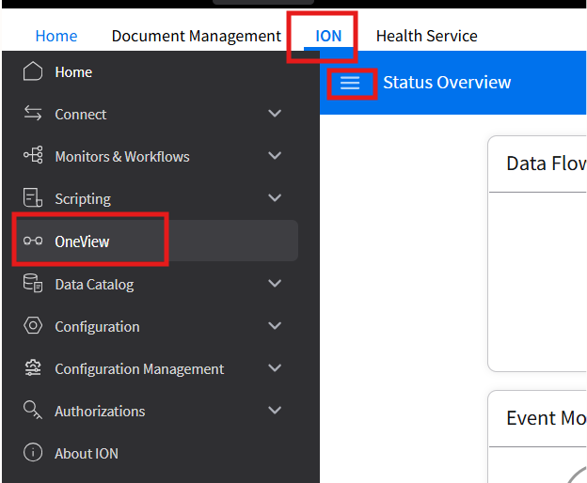
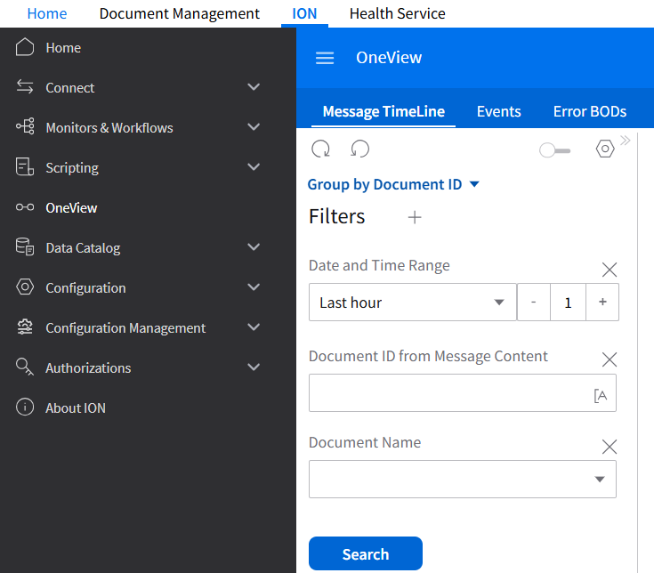
ONE VIEW
1
2
1.) GO TO NAVIGATION MENU
2.) ON APPLICATIONS TAB, CLICK ON OS
3.) CLICK ON ION AND OPEN SHORTCUTS
4.) CLICK ON ONE VIEW
3
4

Slide 13
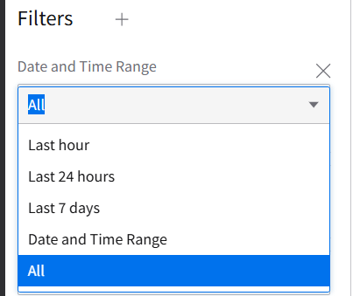
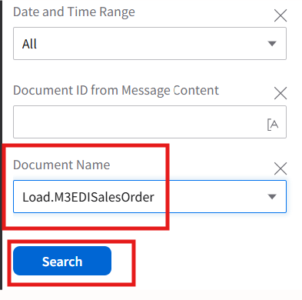
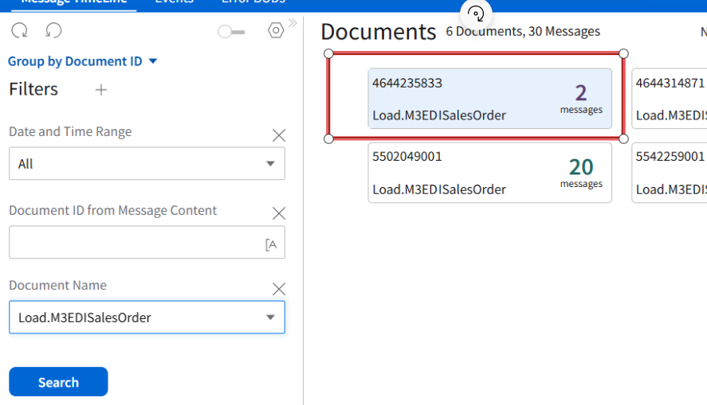
ONE VIEW
6
5
5.) YOU CAN FILTER DATES WHERE YOU WANT TO SEARCH FOR MESSAGES
6.) SEARCH THE DOCUMENT NAME THAT YOU ARE TRYING TO RETRIEVE
6.) CLICK ON THE MESSAGE THAT YOU ARE RETRIEVING
7

Slide 14
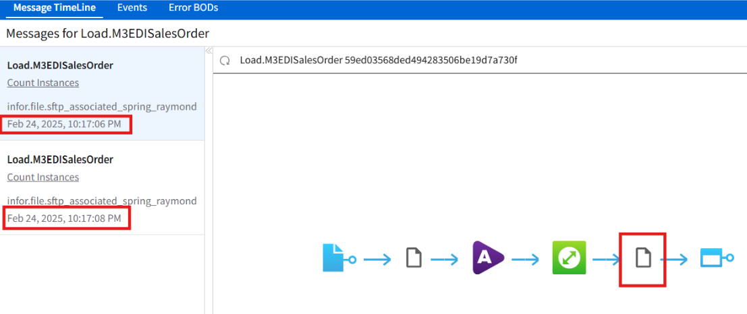
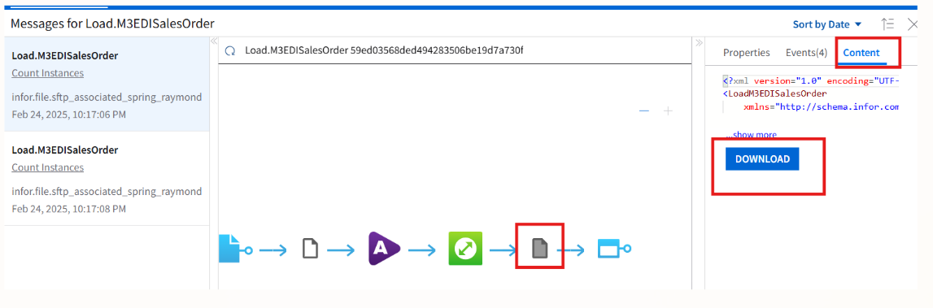
ONE VIEW
8
8.) CLICK ON THE PAPER ICON AND CONTENT TAB
9.) CLICK DOWNLOAD AND OPEN IN NOTEPAD++
9

Slide 15
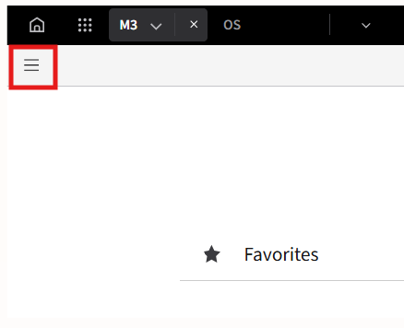
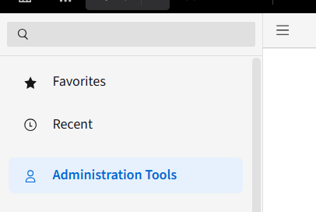
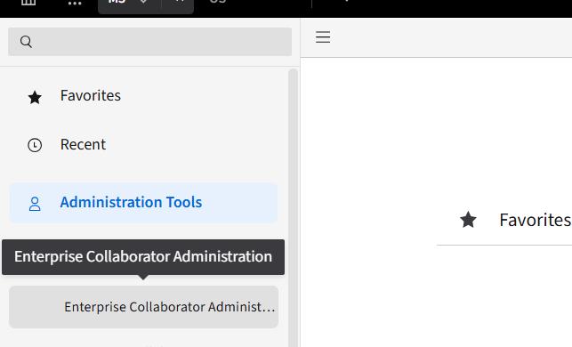
ENTERPRISE COLLABORATOR(EC)
1
2
1.) GO TO M3 AND OPEN LEFT SHORTCUTS PANEL
2.) OPEN ADMINISTRATION TOOLS
3.) CLICK ON ENTERPRISE COLLABORATOR ADMINISTRATION
3

Slide 16
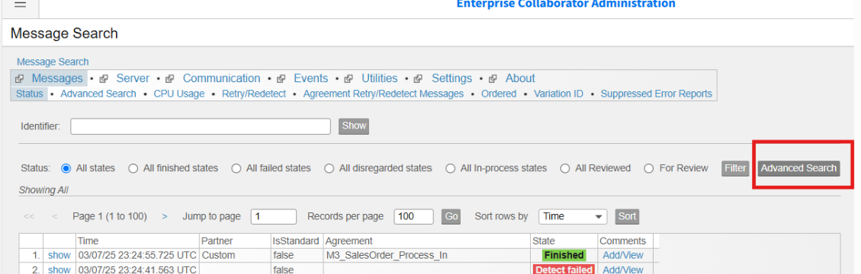
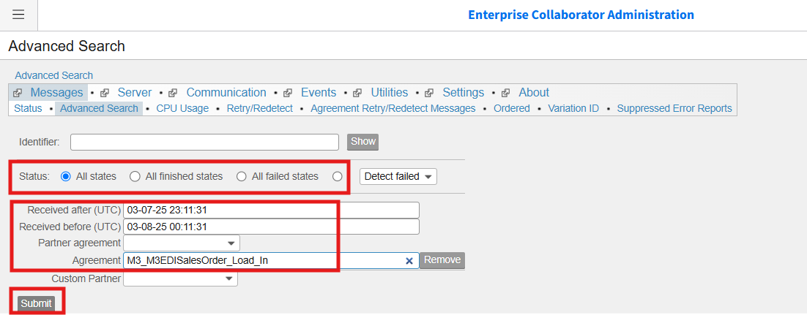
ENTERPRISE COLLABORATOR(EC)
4
4.) CLICK ON ADVANCED SEARCH
5.) SPECIFY DATE AND TIME YOU WANT TO FILTER
6.) FILTER FOR AGREEMENT AND SPECIFY AGREEMENT NAME YOU ARE SEARCHING FOR
5
6

Slide 17
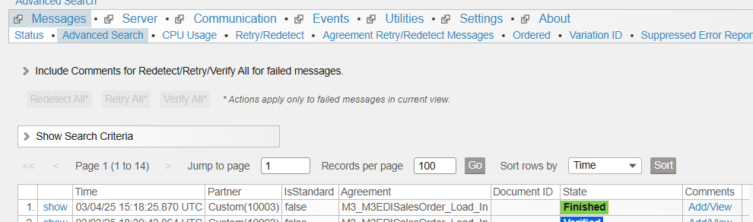
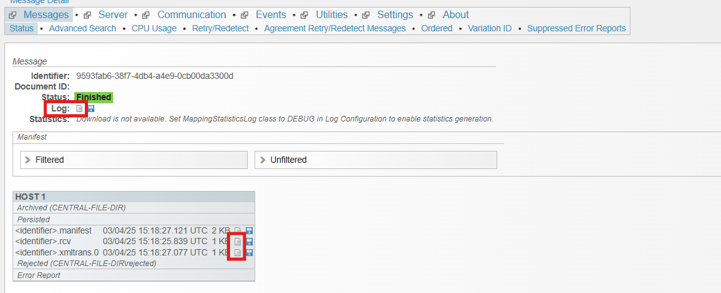
ENTERPRISE COLLABORATOR(EC)
7
7.) CLICK ON SHOW
8.) LOGS WILL GIVE YOU THE ERROR LOGS OF A FAILED MESSAGE
9.) .RCV WILL ALLOW YOU TO DOWNLOAD THE XML OF AN INBOUND FILE
10.) .XMLTRANS WILL ALLOW YOU TO DOWNLOAD THE XML AN OUTBOUND FILE.
11.) OPEN FILES IN NOTEPAD++
8
9
10

Slide 18
TROUBLE SHOOTING – HOW TO READ AN XML

Slide 19
MAPPING FILE FOR EACH INTERFACE

Slide 20
TROUBLE SHOOTING – ERROR HANDLING

Slide 21
HAPPY PATH DEMO

Slide 22
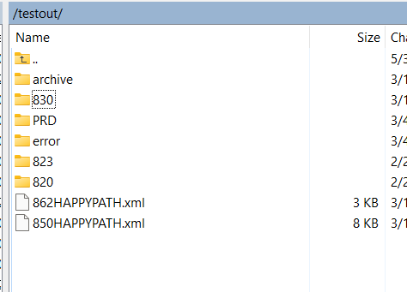
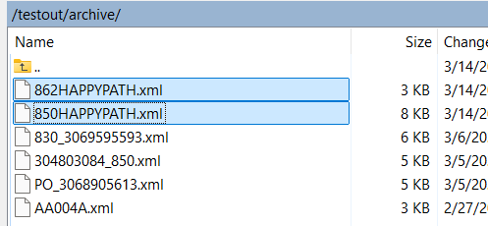
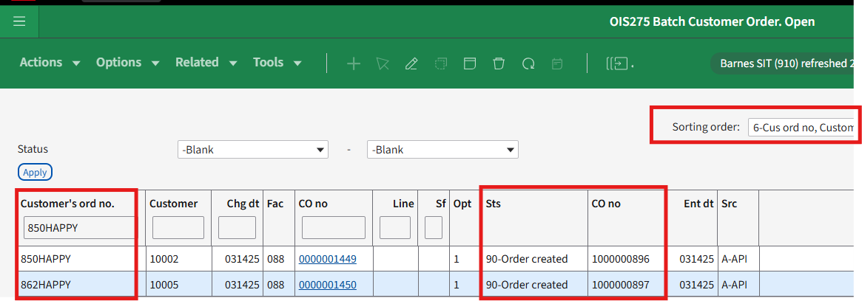
SPS HAPPY PATH
1
2
1.) FILE IS SENT BY SPS TO SFTP FOLDER
2.) ION PICKS UP FILE FROM SFTP
3.) INBOUND AGREEMENT TRIGGERS AND IS A SUCCESS
4.) BATCH ORDER CAN BE SEEN IN OIS275. HAS CORRECT ADDRESS, LINES,EC NUMBERS AND AUXILIARY DETAILS.
3
4

Slide 23
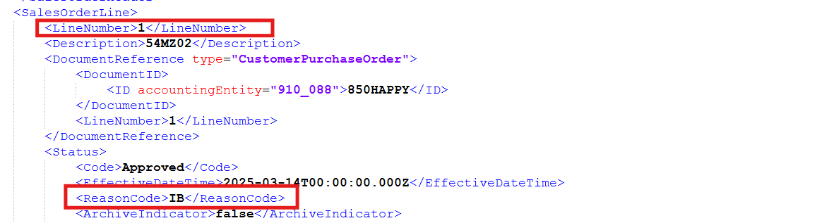
SPS HAPPY PATH
5
5.) AN ACKNOWLEDGEMENT IS AUTOMATICALLY SENT OUT (EDI 855)
6.) ACKNOWLEDGEMENT CODES ARE IN THE RESULTING XML
6

Slide 24
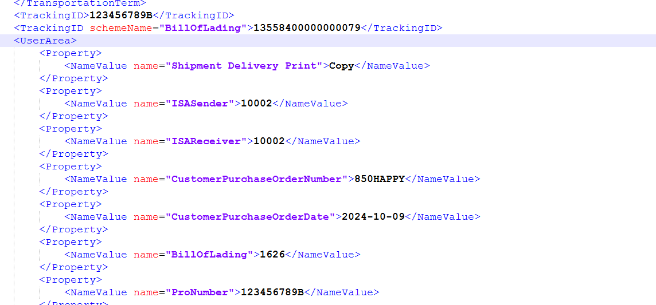
SPS HAPPY PATH
7
7.) ORDER IS PROCESSED THROUGH WAREHOUSE WITH PRO/TRACKING NUMBERS AND EC NUMBERS
8.) EDI 856 IS TRIGGERED AUTOMATICALLY
8

Slide 25

SPS HAPPY PATH
9. ) ORDER IS INVOICED AND BOD AGREEMENT FOR INVOICE TRIGGERS (EDI 810)
10.) INVOICE SHOULD CONTAIN NO TAX
9
10

Slide 26
VALIDATION ERRORS | ORDER LEVEL | ERROR | WILL ORDER GET STUCK | RESOLUTION | DETAILS | SPS | OPTIMIZELY | INBOUND | OUTBOUND
OIS275 | Header | Delivery terms does not exist | Yes | Translation | Check inbound translation in CRS881/882 | X |  | X
OIS275 | Header | Delivery method does not exist | Yes | Translation | Check inbound translation in CRS881/882 | X |  | X
OIS275 | Header | Duplicate PO | No | Configuration | Severity level of customer in OIS278 | X | X | X
OIS275 | Lines | Sales Price does not exist | No | Configuraiton | Check your Sales Price for the Customer | X |  | X
EC | Header | Accounting Entity Null | Yes | Configuration | Configure customer in OIS278 | X | X | X
EC | Header | Translation Does not Exist | Yes | Translation | Check outbound translation of the following: | X |  |  | X
 |  |  |  |  | -> Unit of Measure
 |  |  |  |  | -> Acknowledgement code
EC | Lines | Alias number does not Exist/Incorrect Item | Yes | Configuration | Check your Alias Numbers | X |  | X
EC | Lines | Material does not exist/Incorrect Item | Yes | Configuration | Check if the material is maintained in MMS001 | X | X | X

Slide 27
VALIDATION ERRORS | ORDER LEVEL | ERROR | WILL ORDER GET STUCK | RESOLUTION | DETAILS | SPS | OPTIMIZELY | INBOUND | OUTBOUND
SPS FAILURE | Delivery | Tracking number is not in ASN | No | Process | check that the tracking number and LTL numbers are in the delivery | X |  |  | X
SPS FAILURE | Packages | Daimler Carton is not in ASN | No | Process | check that the cartonizations number and are in the packages of the delivery |  |  |  | X
SPS FAILURE | Invoice | Invoices are coming in with taxes | No | Configuration | check that the customer is in TXS050 |  |  |  | X
OIS275 | Header | credit limit exceeded | No | Integration | The order will have a credit block 3 and will trigger the customer flag workflow | X | x | X
SPS FAILURE | Header | shipping locations not found | No | Translation |  | X |  | X | X
EC | Lines | unit of measure does not exist | Yes | Translation | Check inbound translation in CRS881/882 | X |  | X
EC | Lines | unit of measure does not exist | Yes | Translation | Check outbound translation in CRS881/882 | X |  |  | X
OIS275 | Lines | incorrect price | NO | Manual Intervention | there is a report to run in M3 to check | X |  | X
EC | Header | incorrect shipping fees |  |  | check XML, OPT is the shipping charge code |  | X
 |  | order contains special charges
 |  | incorrect discounts

Slide 28
CONFIGURATION GUIDE – SPS

Slide 29
CONFIGURATION GUIDE DOCUMENT

